Slide 1
Directors

Slide 2
Classic Directors of All Time
Alfred Hitchcock
Stanley Kubrick
Orson Welles
Francis Ford Coppola
Steven Speilberg
Quentin Tarintino
Tim Burton
George Lucas

Slide 3
Alfred Hitchcock
He was an English film director and producer.
He pioneered many techniques in the suspense and psychological thriller genres.
Hitchcock moved to Hollywood in 1939.
He pioneered the use of a camera made to move in a way that mimics a person's gaze, forcing viewers to engage in a form of voyeurism.
He framed shots to maximize anxiety, fear, or empathy, and used innovative film editing.
His stories often feature fugitives on the run from the law alongside "icy blonde" female characters.
Many of Hitchcock's films have twist endings and thrilling plots featuring depictions of violence, murder, and crime.

Slide 4
Hitchcock directed more than fifty feature films in a career spanning six decades.
Hitchcock's films were extensively storyboarded to the finest detail
Hitchcock's work often deviated from how the screenplay was written or how the film was originally envisioned.
His fastidiousness and attention to detail also found its way into each film poster for his films.

Slide 5
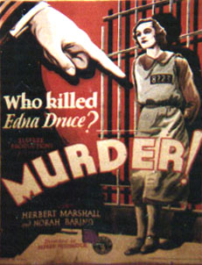
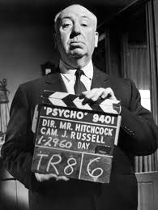
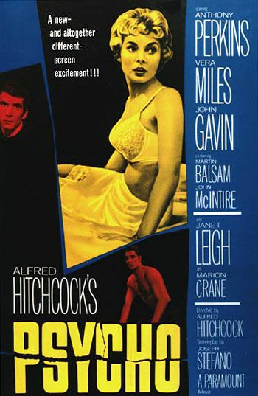
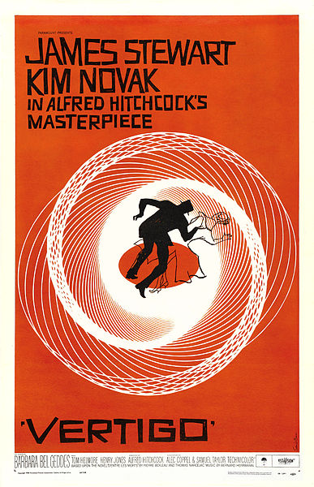

Slide 6
Stanley Kubrick
Stanley Kubrick was an American film director, screenwriter, producer and cinematographer
His films, typically adaptations of novels or short stories, are noted for their "dazzling” and unique cinematography, attention to details to achieve realism and an inspired use of music scores
Kubrick's films covered a variety of genres, including war, crime, romantic and black comedies, horror, epic and science fiction.
Before shooting began, Kubrick tried to have the script as complete as possible, but still allowing himself enough space to make changes during the actual filming.
Kubrick was noted for requiring multiple takes during filming
Actors especially liked that Kubrick would often devote his personal breaks to have lengthy discussions with them so they could gain more confidence.

Slide 7
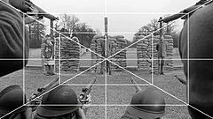
Kubrick was also noted for his attention to accessory details.
In deciding which props and settings would be used, he tried to collect as much background material as possible.
Kubrick's use of “one-point perspective," which leads the viewer's eye towards a central vanishing point. The technique relies on creating a complex visual symmetry using parallel lines in a scene which all converge on that single point, leading away from the viewer.
The Shining was among the first half-dozen features to use the then-revolutionary Steadicam.
Kubrick felt his way towards the final version of a film by shooting each scene from many angles and demanding scores of takes on each line.
He preferred selecting recorded music over having it composed for a film.

Slide 8
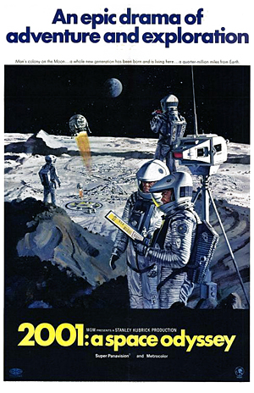
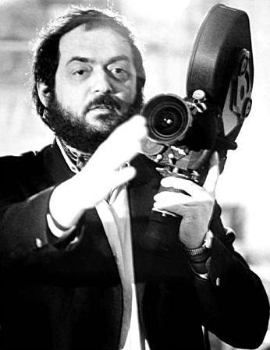
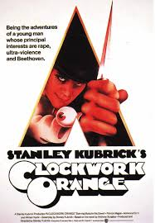
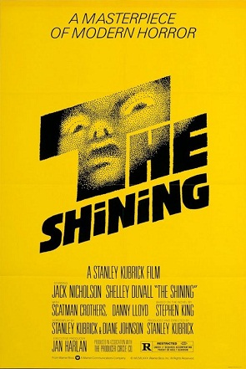

Slide 9
Orson Welles
George Orson Welles was an American actor, director, writer and producer who worked in theater, radio and film.
He is best remembered for his innovative work in all three media.
His first film was Citizen Kane (1941), which he co-wrote, produced, directed, and starred in as Charles Foster Kane.
He directed only 13 full-length films in his career.
His distinctive directorial style featured layered and nonlinear narrative forms, innovative uses of lighting, unusual camera angles, sound techniques borrowed from radio, deep focus shots, and long takes.

Slide 10
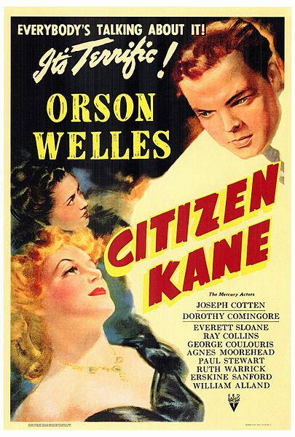
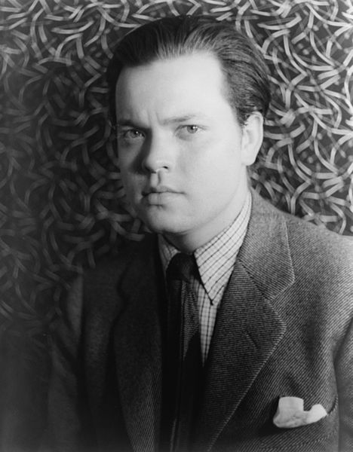
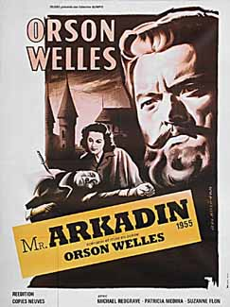
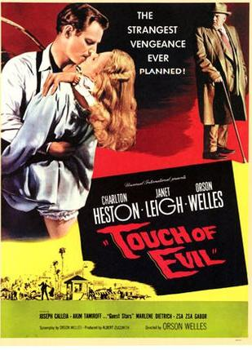

Slide 11
Francis Ford Coppola
Francis Ford Coppola is an American film director, producer and screen writer.
Coppola’s distaste for the gangster genre keeps nudging the movie The godfather in another, far richer direction.
When he is filming, he does not put too many unnecessary items into the scene. When using a Wide-angle lens, the frames are very open and spacious.
Francis Ford Coppola uses sound in a rather conventional way, but at times adds a touch of his own creative style.

Slide 12
Wary of enforcing stereotypes about Italians and Sicilians, Coppola turned the luxuriant saga of the Corleone crime family into a metaphor for American capitalism and the utter ruthlessness with which business gets done in their adopted country. In the end, Paramount got the violent, commercially appealing shoot-’em-up they wanted and Coppola got the subtext and cultural authenticity that transformed The Godfather into a classic.

Slide 13
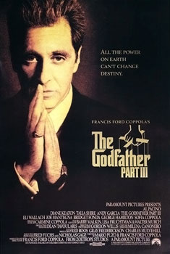
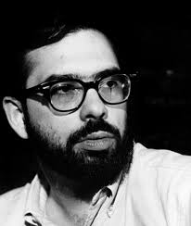
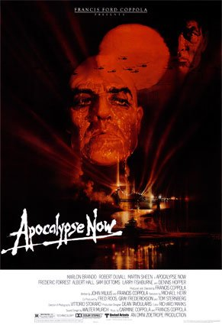
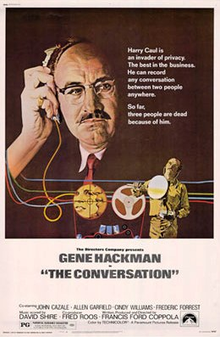

Slide 14
Steven Speilberg
Steven Allan Spielberg is an American business magnate, film director, screenwriter, and producer.
His films have covered many themes and genres. Spielberg's early science-fiction and adventure films were seen as archetypes of modern Hollywood blockbuster filmmaking.
In later years, his films began addressing humanistic issues such as the Holocaust, the transatlantic slave war, war, and terrorism.
He is also one of the co-founders of Dreamworks movie studio.
Most of his films deal with ordinary characters searching for or coming in contact with extraordinary beings or finding themselves in extraordinary circumstances.

Slide 15
A strong consistent theme in his family-friendly work is a childlike, even naïve, sense of wonder and faith.
If one views each of his films, one will see this shot utilized by the director, notably the water scenes in Jaws are filmed from the low-angle perspective of someone swimming. Another child oriented theme in Spielberg's films is that of loss of innocence and coming-of-age.
The most persistent theme throughout his films is tension in parent-child relationships.
Most of his films are generally optimistic in nature.

Slide 16
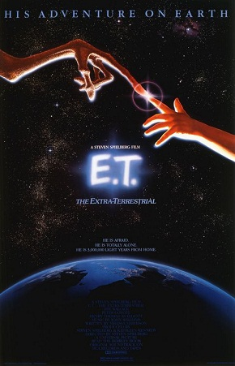
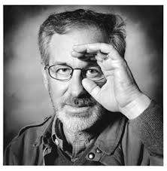
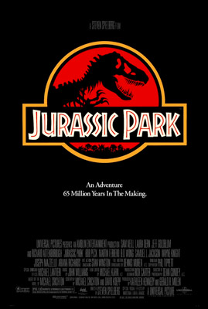
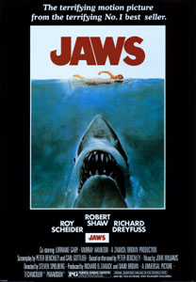

Slide 17
Quentin Tarintino
Quentin Jerome Tarantino is an American film director, screenwriter, producer, and actor.
His films have been characterized by nonlinear storylines, satirical subject matter, and an aestheticization of that often results in the exhibition of neo-noir characteristics.
He often uses graphic violence that has been proven seductive to audiences and has received harsh criticism for his use of gore and blood in an entrancing simultaneously repulsive way. His films have been subject to staunch criticism and scorn for his use of violence, blood and action as a "colour" within cinema, rebuked for allegedly using human suffering as a punchline.

Slide 18
According to Tarantino, a recurring hallmark in all his movies is that there is a different sense of humor in each one, which gets the audience to laugh at things that aren't funny.
Tarantino has stated that the celebrated animation-action sequence in his film Kill Bill (2003) was his rebirth in directing.
More specifically, he often attempts to meld comic strip formulas and aesthetics within a live action film sequence and in some cases uses the literal use of cartoon or anime images.
Tarantino's cinematic ambition to marry artistic expression via live action and cartoonism is yet another example of his ability to morph genres and conventions to produce a new and authentic style of his own.

Slide 19
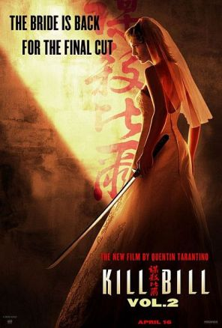
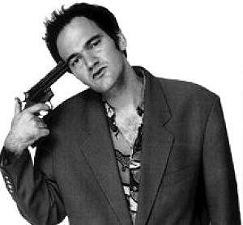
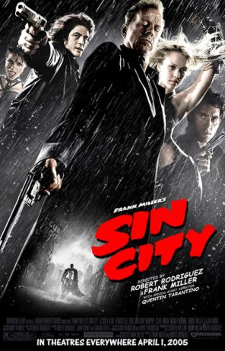
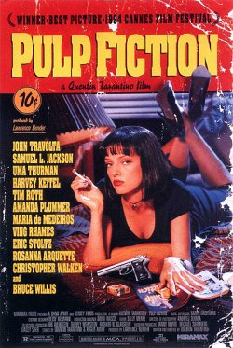

Slide 20
Tim Burton
Timothy Walter "Tim" Burton is an American film director, film producer, writer, artist animator.
He is famous for his dark, gothic, macabre and quirky take on horror and fantasy style movies such as Beetlejuice, Edward Scissorhands, The Nightmar Before Christmas, Ed Wood, Sleepy Hollow, Corpse Bride, Sweeney Todd and for blockbusters such as Batman, its first sequel Batman Returns, Planet of the Apes, Charlie and the Chocolate Factory, and Alice in Wonderland.
Burton has directed 16 films and produced 12 as of 2012. His latest films are an adaptation of the soap opera Dark Shadows, released on May 10, 2012.

Slide 21
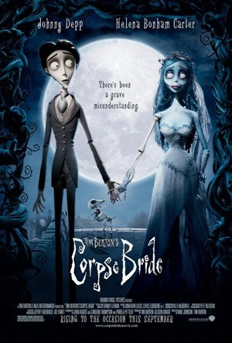
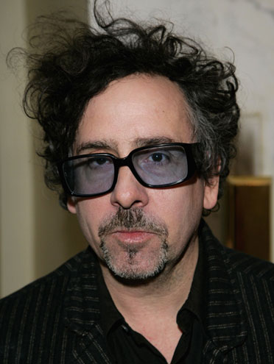
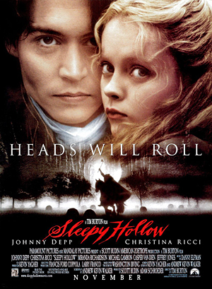
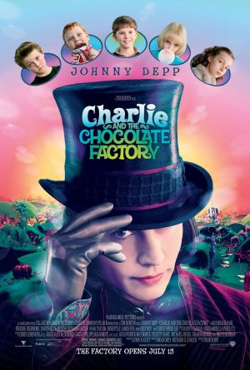

Slide 22
George Lucas
George Walton Lucas, Jr. is an American film producer, screenwriter, director, and entrepreneur. He founded Lucasfilms limited and led the company as chairman and chief executive before selling it to The Walt Disney Company on October 30, 2012.
He is best known as the creator of the space opera franchise Star Wars and the archaeologist adventurer character Indiana Jones. Lucas is one of the American film industry's most successful filmmakers financially.
Lucas started as one of the most avant-garde filmmakers. He was interested in making documentaries and other non-narrative films. Many of them concerned either cars or music. One of the short films he made was called The Emperor (no, not that Emperor) about a radio DJ. The highly experimental and non-conformist style of his short films would carry over to his first feature film.

Slide 23
