Slide 1
Learning Objective:
To understand and explore the term ‘mise-en-scene’.

Slide 2
Definition: Mise En Scene
A French term meaning what is put into a scene or frame
Visual information in front of the camera
Communicates essential information to the audience
Made up of 5 elements: Can you guess what they are?

Slide 3
The 5 Elements of Mise en Scene
Each aspect of mise-en-scene has hidden meanings within a film and sends signals to the audience about how we are supposed to feel at a certain point
Settings & Props
Costume, Hair & Make Up
Facial Expressions & Body Language
Lighting & Colour
Positioning of characters/objects within the frame

Slide 4
1. Settings & Props
Settings & Locations play an important part in film-making and are not just ‘backgrounds’
Sets are either built from scratch or a great deal of time is spent to find a setting which already exists
Settings can manipulate an audience by building certain expectations and then taking a different turn
What settings and props you would find in:
A Science Fiction Film
A Romantic Comedy
A Horror Film

Slide 5
2. Costume, Hair & Make Up
Costume, Hair & Make Up act as an instant indicator to us of a character’s personality, status & job
It tells us immediately whether the film is set in the present and what society/or culture it will centre around
Certain costumes can signify certain individuals (i.e. black cloak of a vampire, Spidey’s Spiderman suit)

Slide 6
3. Facial Expressions & Body Language
Facial Expressions provide a clear indicator of how someone is feeling
If someone is smiling broadly, we assume they are happy but we may get a different feeling if this is accompanied by scary music
Body Language may also indicate how a character feels towards another character or may reflect the state of their relationship
TASK: What meanings/emotions do the following images convey:

Slide 7
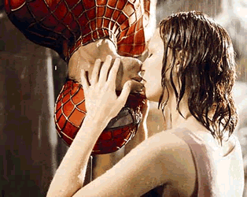
IMAGE 1

Slide 8
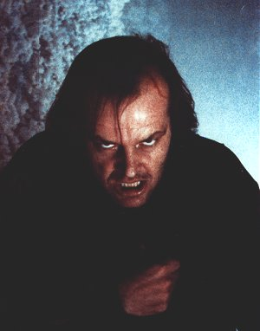
IMAGE 2

Slide 9
4. Positioning of Characters & Objects within a frame
Positioning within a frame can draw our attention to an important character/object
A film-maker can use positioning to indicate relationships between people
What does the positioning in the following images reveal about the characters/film:

Slide 10
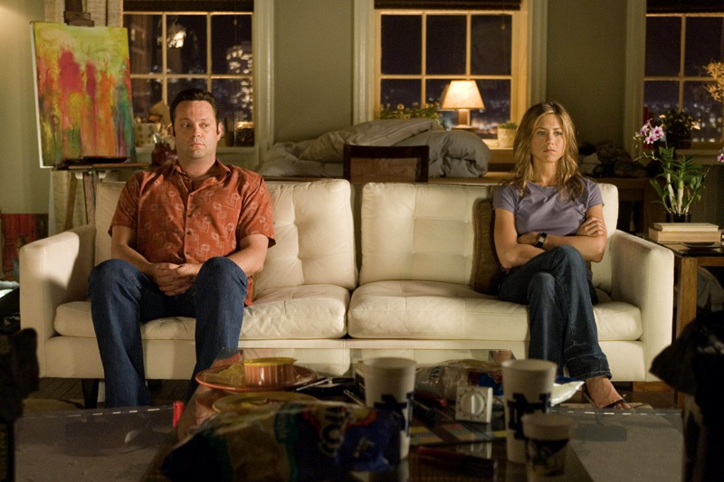
IMAGE 1

Slide 11
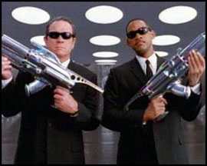
IMAGE 2

Slide 12
5. Lighting & Colour
Lighting & Colour can be used to achieve a variety of effects:
To highlight important characters or objects within the frame
To make characters look mysterious by shading sections of the face & body
To reflect a characters mental state/hidden emotions (i.e. bright = happy, dark = disturbed, strobe effect = confused

Slide 13
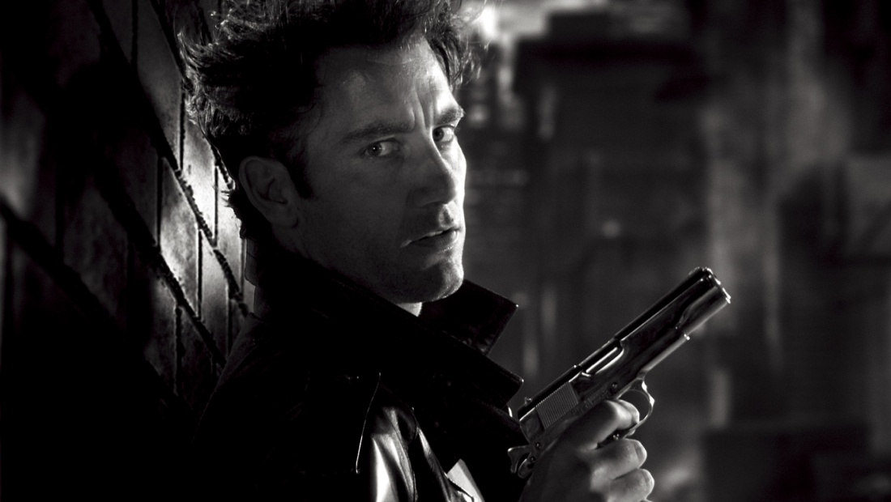
Types of Lighting
LOW KEY LIGHTING:
Created by using only the key & back lights
Produces sharp contrasts of light and dark areas
Deep, distinct shadows/silhouettes are formed
Example: Horror Films

Slide 14
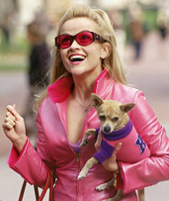
Types of Lighting
HIGH KEY LIGHTING:
More filler lights are used. Lighting is natural and realistic to our eyes
Produces brightly lit sets or a sunny day (right)
Example: Rom-Coms

Slide 15
Look at the next screen shot: an establishing shot.
What does the mise-en-scene tell you about the location?
Think about:
Lighting
Location
Colour
Props

Slide 16
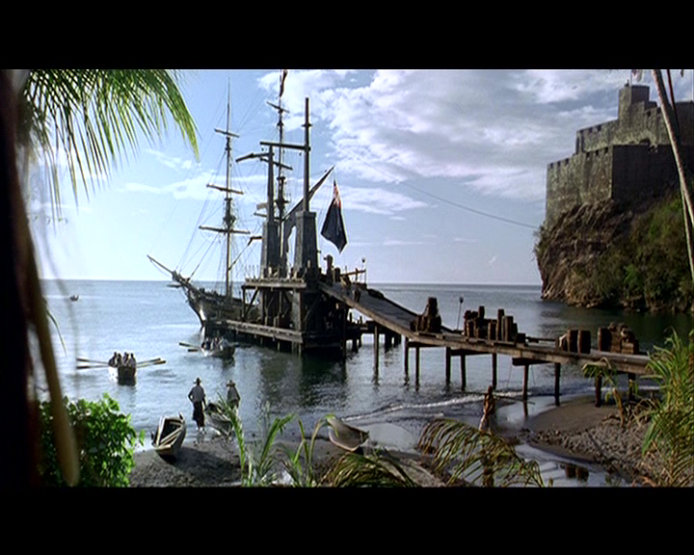

Slide 17
Lots of blue colour:
Connotations of sea, calm, cool
Props: all adding to the nautical/sea theme of the film
The sea: Caribbean location, pirates
Lighting: natural and bright, so tranquil and happy mood in the scene

Slide 18
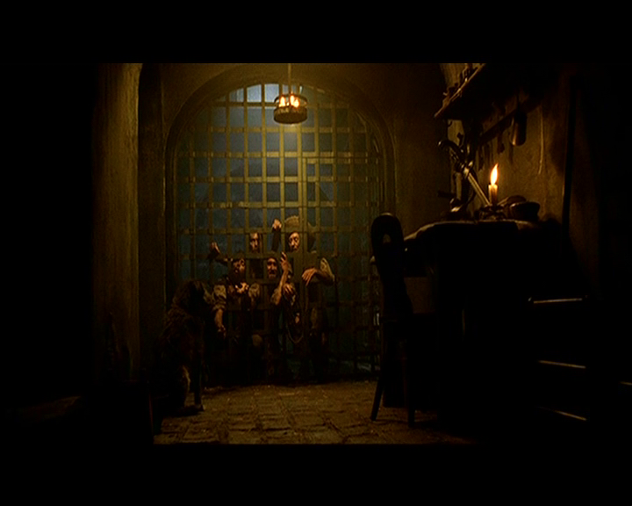
Lighting and set

Slide 19
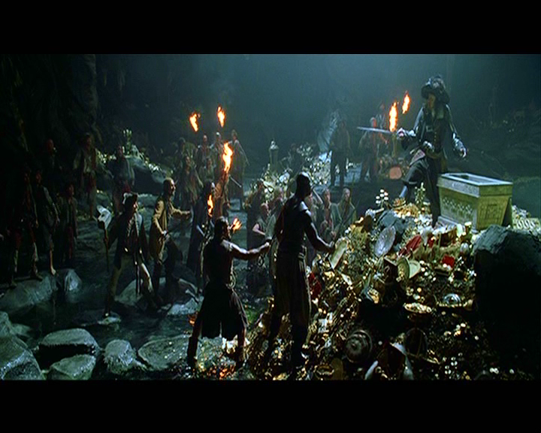
Props and costume

Slide 20
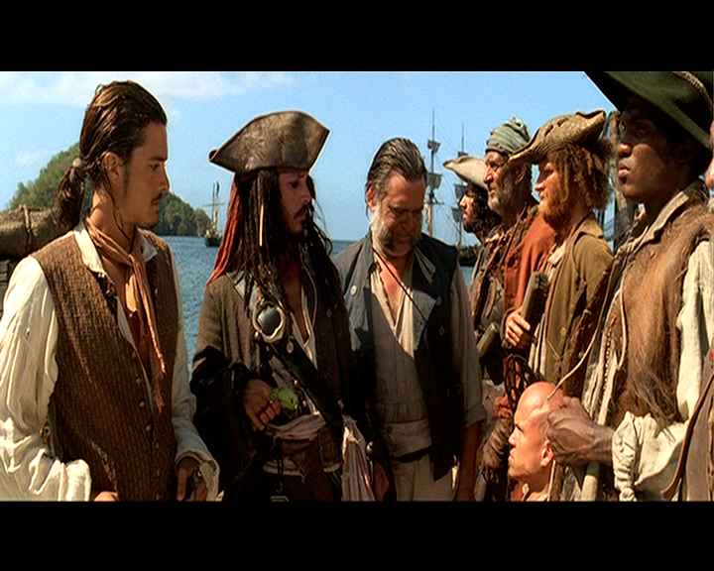
Costume and expression

